Slide 1
[220 / 319] Dictionary Nesting
Meena Syamkumar
Andy Kuemmel
Cole Nelson
Readings:
Chapter 11 of Think Python
Due: P6
Grade posted: P5

Slide 2
Learning Objectives Today
More dictionary operations
len, in, for loop
d.keys(), d.values()
defaults for get and pop
Syntax for nesting (dicts inside dicts, etc)
indexing/lookup
step-by-step resolution
Understand common use cases for nesting
binning/bucketing (list in dict)
a more convenient table representation (dict in list)
transition probabilities with Markov chains (dict in dict)
list
dict
dict
dict
one of the most common
data analysis tasks
we’ll generate random
English-like texts

Slide 3
Today's Outline
Dictionary Ops
Binning (dict of list)
Table Representation (list of dict)
Probability Tables and Markov Chains (dict of dict) – self-interest study; not required for quizzes and exams

Slide 4
Creation of Empty Dict - self-review
Non-empty dict:
d = {“a”: “alpha”, “b”: “beta”}
Empty dict (way 1):
d = {}
Empty dict (way 2):
d = dict() # special function called constructor
similar for lists: L = []
similar for lists: L = list() # special function called constructor
similar for sets: s = set() # special function called constructor

Slide 5
len, in, for - self-review
num_words = {0:“zero”, 1:”one”, 2:”two”, 3:”three”}
print(len(num_words))
print(1 in num_words)
print(“one” in num_words)
for x in num_words:
print(x, num_words[x])
4
True
False (it is only checking keys, not vals)
0 zero
1 one
2 two
3 three
you can iterate over values
by combining a for loop with lookup

Slide 6
Extracting keys and values
num_words = {0:“zero”, 1:”one”, 2:”two”, 3:”three”}
print(type(num_words.keys()))
print(type(num_words.values()))
<class 'dict_keys'>
<class 'dict_values'>
don’t worry about these
new types, because we
can force them to be lists

Slide 7
Extracting keys and values
num_words = {0:“zero”, 1:”one”, 2:”two”, 3:”three”}
print(type(num_words.keys()))
print(type(num_words.values()))
print(list(num_words.keys()))
print(list(num_words.values()))
<class 'dict_keys'>
<class 'dict_values'>
[0, 1, 2, 3]
[ “zero”, “one”,
“two”, “three”]

Slide 8
Defaults with get and pop
suffix = {1:“st”, 2:”nd”, 3:”rd”}
suffix.pop(0) # delete fails, because no key 0
suffix[4] # lookup fails because no key 4

Slide 9
Defaults with get and pop
suffix = {1:“st”, 2:”nd”, 3:”rd”}
suffix.pop(0) # delete fails, because no key 0
suffix[4] # lookup fails because no key 4
suffix.get(4, “th”) # returns “th” because no key 4
specify a default if
key cannot be found

Slide 10
Defaults with get and pop
suffix = {1:“st”, 2:”nd”, 3:”rd”}
suffix.pop(0) # delete fails, because no key 0
suffix[4] # lookup fails because no key 4
suffix.get(4, “th”) # returns “th” because no key 4
specify a default if
key cannot be found
specify a default if
key cannot be found

Slide 11
Defaults with get and pop
suffix = {1:“st”, 2:”nd”, 3:”rd”}
suffix.pop(0, “th”) # returns “th” because no key 0
suffix[4] # lookup fails because no key 4
suffix.get(4, “th”) # returns “th” because no key 4
specify a default if
key cannot be found
specify a default if
key cannot be found

Slide 12
Defaults with get and pop
suffix = {1:“st”, 2:”nd”, 3:”rd”}
for num in range(6): print(str(num) + suffix.get(num, “th”))
0th
1st
2nd
3rd
4th
5th

Slide 13
Today's Outline
Dictionary Ops
Binning (dict of list)
Table Representation (list of dict)
Probability Tables and Markov Chains (dict of dict) – self-interest study; not required for quizzes and exams

Slide 14
Bucketizing/Binning
all
rows
LEC001
LEC002
LEC003

Slide 15
Bucketizing/Binning
all
rows
for
loop
LEC001
LEC002
LEC003
2017
2018
2019

Slide 16
Bucketizing/Binning
all
rows
for
loop
LEC001 | 19 | ...
LEC001
LEC002
LEC003
2017
2018
2019

Slide 17
Bucketizing/Binning
all
rows
for
loop
LEC001 | 19 | ...
LEC001
LEC002
LEC003
2017
2017
2018
2018
2019
2019

Slide 18
Bucketizing/Binning
all
rows
for
loop
LEC001
LEC002
LEC003
2017
2018
2019

Slide 19
Bucketizing/Binning
all
rows
for
loop
LEC002 | 18 | ...
LEC001
LEC002
LEC003
2017
2018
2019

Slide 20
Bucketizing/Binning
all
rows
for
loop
LEC002 | 18 | ...
LEC001
LEC002
LEC003
2017
2018
2019

Slide 21
Bucketizing/Binning
all
rows
for
loop
LEC002 | 18 | ...
dict
LEC001
LEC002
LEC003
2017
2018
2019

Slide 22
Bins with lists and dicts
all data
rows = [
["LEC001”, 19, ”CS”],
[”LEC002”, 18, “Eng”],
[”LEC002”, 21, “Econ”],
[”LEC003”, 25, ”Stat”],
[”LEC002”, , ”DS”],
[”LEC003”, , ”DS”],
]

Slide 23
Bins with lists and dicts
bins = {
”LEC001”: [
["LEC001”, 19, ”CS”],
],
”LEC002”: [
[”LEC002”, 18, “Eng”],
[”LEC002”, 21, “Econ”],
[”LEC002”, , ”DS”],
],
”LEC003”: [
[”LEC003”, 25, ”Stat”],
[”LEC003”, , ”DS”],
]
}
all data
rows = [
["LEC001”, 19, ”CS”],
[”LEC002”, 18, “Eng”],
[”LEC002”, 21, “Econ”],
[”LEC003”, 25, ”Stat”],
[”LEC002”, , ”DS”],
[”LEC003”, , ”DS”],
]

Slide 24
Bins with lists and dicts
bins = {
”LEC001”: [
["LEC001”, 19, ”CS”],
],
”LEC002”: [
[”LEC002”, 18, “Eng”],
[”LEC002”, 21, “Econ”],
[”LEC002”, , ”DS”],
],
”LEC003”: [
[”LEC003”, 25, ”Stat”],
[”LEC003”, , ”DS”],
]
}
all data
avg 19
rows = [
["LEC001”, 19, ”CS”],
[”LEC002”, 18, “Eng”],
[”LEC002”, 21, “Econ”],
[”LEC003”, 25, ”Stat”],
[”LEC002”, , ”DS”],
[”LEC003”, , ”DS”],
]
avg 19.5
avg 25

Slide 25
Demo 1: Average Age per Section
Goal: print average age of students in each section
Input:
CS220 Information survey
Output:
Average age within each section
Example: SEC001: 19 SEC002: 19.5 SEC003: 25

Slide 26
Today's Outline
Dictionary Ops
Binning (dict of list)
Table Representation (list of dict)
Probability Tables and Markov Chains (dict of dict)

Slide 27
Table Representation
name | x | y
Alice | 30 | 20
Bob | 5 | 11
Cindy | -2 | 50
list of list representation
list of dict representation
header = [“name”, “x”, “y”]
rows = [
[“Alice”, 30, 20],
[“Bob”, 5, 11],
[“Cindy”, -2, 50],
]
[
{“name”:“Alice”, “x”:30, “y”:20},
{“name”:“Bob”, “x”:5, “y”:11},
{“name”:“Cindy”, “x”:-2, “y”:50},
]

Slide 28
Table Representation
name | x | y
Alice | 30 | 20
Bob | 5 | 11
Cindy | -2 | 50
list of list representation
list of dict representation
header = [“name”, “x”, “y”]
rows = [
[“Alice”, 30, 20],
[“Bob”, 5, 11],
[“Cindy”, -2, 50],
]
[
{“name”:“Alice”, “x”:30, “y”:20},
{“name”:“Bob”, “x”:5, “y”:11},
{“name”:“Cindy”, “x”:-2, “y”:50},
]
2
2
"y"
2
rows[2][header.index(“y”)]
rows[2][“y”]

Slide 29
Demo 2: Table Transform
Goal: create function that transforms list of lists table to a list of dicts table
Input:
List of lists (from a CSV)
Output:
List of dicts
Example: >>> header = [“x”,”y”] >>> rows = [[1,2], [3,4]] >>> transform(header, rows) [{“x”:1, “y”:2}, {“x”:3, “y”:4}]

Slide 30
Today's Outline
Dictionary Ops
Binning (dict of list)
Table Representation (list of dict)
Probability Tables and Markov Chains (dict of dict) – self-interest study; not required for quizzes and exams

Slide 31
Challenge - Demo 3: Letter Frequency
53‡‡†305))6*;4826)4‡.)4‡);806*;48†8
¶60))85;;]8*;:‡*8†83(88)5*†;46(;88*96
*?;8)*‡(;485);5*†2:*‡(;4956*2(5*—4)8
¶8*;4069285);)6†8)4‡‡;1(‡9;48081;8:8‡
1;48†85;4)485†528806*81(‡9;48;(88;4
(‡?34;48)4‡;161;:188;‡?;
can you guess what 8 represents?

Slide 32
Challenge - Demo 3: Letter Frequency
53‡‡†305))6*;4826)4‡.)4‡);806*;48†8
¶60))85;;]8*;:‡*8†83(88)5*†;46(;88*96
*?;8)*‡(;485);5*†2:*‡(;4956*2(5*—4)8
¶8*;4069285);)6†8)4‡‡;1(‡9;48081;8:8‡
1;48†85;4)485†528806*81(‡9;48;(88;4
(‡?34;48)4‡;161;:188;‡?;
can you guess what 8 represents?
https://en.wikipedia.org/wiki/The_Gold-Bug

Slide 33
Challenge - Demo 3: Letter Frequency
letters
symbols
how to compute these?
https://en.wikipedia.org/wiki/The_Gold-Bug

Slide 34
Challenge - Demo 3: Letter Frequency
Goal: if we randomly pick a word in a text, what is the probability that it will be a given letter?
Input:
Plaintext of book (from Project Gutenberg)
Output:
The portion of letters in the text that are that letter
Example: text: AAAAABBCCC A: 50% B: 20% C: 30%
https://en.wikipedia.org/wiki/The_Gold-Bug

Slide 35
Sequence Data
Consider this sequence: “the quick tiger is quiet”
What letter likely comes after “t” in this text?

Slide 36
Sequence Data
Consider this sequence: “the quick tiger is quiet”
What letter likely comes after “t” in this text?
Next Letter | Probability
h | 50%
i | 50%
a | 0%
… | 0%
dict for “t”:
{“h”: 0.5, “i”: 0.5}

Slide 37
Sequence Data
Consider this sequence: “the quick tiger is quiet”
What letter likely comes after “t” in this text?
What letter likely comes after “q” in this text?
Next Letter | Probability
h | 50%
i | 50%
a | 0%
… | 0%
dict for “t”:
{“h”: 0.5, “i”: 0.5}
Next Letter | Probability
u | 100%
… | 0%
dict for “q”:
{“u”: 1.0}

Slide 38
Sequence Data
Imagine a next-letter probability
dictionary for every letter
Consider this sequence: “the quick tiger is quiet”
What letter likely comes after “t” in this text?
What letter likely comes after “q” in this text?
Next Letter | Probability
h | 50%
i | 50%
a | 0%
… | 0%
dict for “t”:
{“h”: 0.5, “i”: 0.5}
Next Letter | Probability
u | 100%
… | 0%
dict for “q”:
{“u”: 1.0}

Slide 39
Sequence Data
Imagine a next-letter probability
dictionary for every letter
Consider this sequence: “the quick tiger is quiet”
What letter likely comes after “t” in this text?
What letter likely comes after “q” in this text?
dict for “u”:
{“i”: 1.0}
Next Letter | Probability
h | 50%
i | 50%
a | 0%
… | 0%
dict for “t”:
{“h”: 0.5, “i”: 0.5}
dict for “i”:
{“c”: 0.25, “g”: 0.25, “s”: 0.25, “e”: 0.25}
Next Letter | Probability
u | 100%
… | 0%
dict for “q”:
{“u”: 1.0}
…

Slide 40
Sequence Data
Organize all the dicts with a dict:
Imagine a next-letter probability
dictionary for every letter
probs = {
“u”:
}
dict for “u”:
{“i”: 1.0}
dict for “t”:
{“h”: 0.5, “i”: 0.5}
dict for “i”:
{“c”: 0.25, “g”: 0.25, “s”: 0.25, “e”: 0.25}
dict for “q”:
{“u”: 1.0}
…

Slide 41
Sequence Data
Organize all the dicts with a dict:
Imagine a next-letter probability
dictionary for every letter
probs = {
“u”: {“i”: 1.0},
}
dict for “u”:
{“i”: 1.0}
dict for “t”:
{“h”: 0.5, “i”: 0.5}
dict for “i”:
{“c”: 0.25, “g”: 0.25, “s”: 0.25, “e”: 0.25}
dict for “q”:
{“u”: 1.0}
…

Slide 42
Sequence Data
Organize all the dicts with a dict:
Imagine a next-letter probability
dictionary for every letter
probs = {
“u”: {“i”: 1.0},
“t”: {“h”: 0.5, “i”: 0.5}
“i”: {“c”: 0.25, “g”: 0.25, “s”: 0.25, “e”: 0.25},
“q”: {“u”: 1.0},
…
}
dict for “u”:
{“i”: 1.0}
dict for “t”:
{“h”: 0.5, “i”: 0.5}
dict for “i”:
{“c”: 0.25, “g”: 0.25, “s”: 0.25, “e”: 0.25}
dict for “q”:
{“u”: 1.0}
…

Slide 43
Sequence Data
Organize all the dicts with a dict:
Imagine a next-letter probability
dictionary for every letter
probs = {
“u”: {“i”: 1.0},
“t”: {“h”: 0.5, “i”: 0.5}
“i”: {“c”: 0.25, “g”: 0.25, “s”: 0.25, “e”: 0.25},
“q”: {“u”: 1.0},
…
}
dict for “u”:
{“i”: 1.0}
dict for “t”:
{“h”: 0.5, “i”: 0.5}
dict for “i”:
{“c”: 0.25, “g”: 0.25, “s”: 0.25, “e”: 0.25}
probs[“i”]
dict for “q”:
{“u”: 1.0}
…

Slide 44
Sequence Data
Organize all the dicts with a dict:
Imagine a next-letter probability
dictionary for every letter
probs = {
“u”: {“i”: 1.0},
“t”: {“h”: 0.5, “i”: 0.5}
“i”: {“c”: 0.25, “g”: 0.25, “s”: 0.25, “e”: 0.25},
“q”: {“u”: 1.0},
…
}
dict for “u”:
{“i”: 1.0}
dict for “t”:
{“h”: 0.5, “i”: 0.5}
dict for “i”:
{“c”: 0.25, “g”: 0.25, “s”: 0.25, “e”: 0.25}
probs[“i”][“e”] 0.25
There is a 25% probability that the letter following an “i” is an “e”
dict for “q”:
{“u”: 1.0}
…

Slide 45
Vocabulary
probs = {
“u”: {“i”: 1.0},
“t”: {“h”: 0.5, “i”: 0.5}
“i”: {“c”: 0.25, “g”: 0.25, “s”: 0.25, “e”: 0.25},
“q”: {“u”: 1.0},
…
}
The collection of transition probabilities like this is sometimes called a “stochastic matrix”
Processes that make probabilistic transitions
like this (e.g., from one letter to the next) are
called “Markov chains”

Slide 46
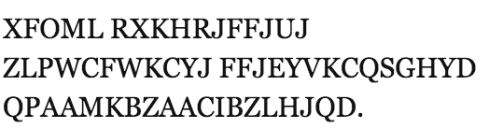
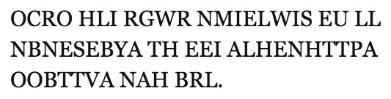
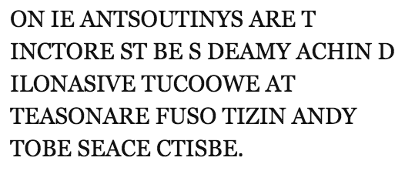
Random Text Generation
1
which looks
closest to
English?
2
3
Examples from A Mind at Play, by Soni and Goodman

Slide 47
Random Text Generation
all letters equally likely
weighted random, based
on frequency in a text
(implement with dict)
probability of each letter
based on previous letter
(implement with dict of dicts)
Examples from A Mind at Play, by Soni and Goodman

Slide 48
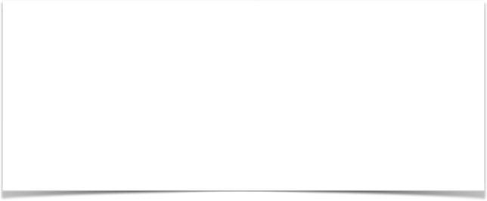
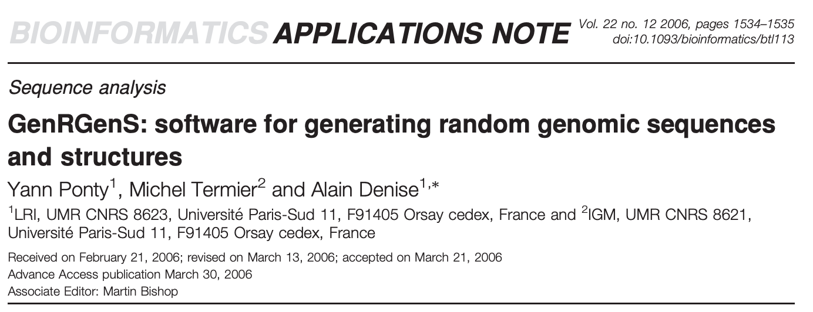
Hypothetical Use Case
DNA sequences
GATACAGATACAGATACA
stochastic model
GCTATAGCTATAGCGCGC
AAAATTTTAAAATTTTAAAA
CATCATC?TC?TCATC?TCAT
CATCATCATCATCATCATCAT
synthetic sequences,
filling in gaps

Slide 49
Challenge - Demo 4: Conditional Letter Frequency
Goal: if we look at given letter, what is the next letter likely to be?
Input:
Plaintext of book (from Project Gutenberg)
Output:
Transition probabilities
Randomly generated text, based on probabilities

Slide 50
Weighted Random
transitions = { “up”: 0.2, “down”: 0.1, “flat”: 0.7 }

Slide 51
Weighted Random
transitions = { “up”: 0.2, “down”: 0.1, “flat”: 0.7 }
up
flat
down
0
0.2
0.4
0.6
0.8
1
probabilities

Slide 52
Weighted Random
transitions = { “up”: 0.2, “down”: 0.1, “flat”: 0.7 }
x = random.random()
up
flat
down
0
0.2
0.4
0.6
0.8
1
probabilities

Slide 53
Weighted Random
transitions = { “up”: 0.2, “down”: 0.1, “flat”: 0.7 }
x = random.random() # assume 0.5
up
flat
down
0
0.2
0.4
0.6
0.8
1
probabilities

Slide 54
Weighted Random
transitions = { “up”: 0.2, “down”: 0.1, “flat”: 0.7 }
x = random.random() # assume 0.5
flat “wins”
up
flat
down
0
0.2
0.4
0.6
0.8
1
probabilities

Slide 55
Weighted Random
transitions = { “up”: 0.2, “down”: 0.1, “flat”: 0.7 }
x = random.random() # assume 0.25
up
flat
down
0
0.2
0.4
0.6
0.8
1
probabilities

Slide 56
Weighted Random
transitions = { “up”: 0.2, “down”: 0.1, “flat”: 0.7 }
x = random.random() # assume 0.25
up
flat
down
0
0.2
0.4
0.6
0.8
1
probabilities

Slide 57
Weighted Random
transitions = { “up”: 0.2, “down”: 0.1, “flat”: 0.7 }
x = random.random() # assume 0.25
down “wins”
up
flat
down
0
0.2
0.4
0.6
0.8
1
probabilities

Slide 58
Weighted Random
x
transitions = { “up”: 0.2, “down”: 0.1, “flat”: 0.7 }
x = random.random() # assume 0.25
end = 0 keys = [“up”, “down”, “flat”] winner = None for key in keys: end += transitions[key] if end >= x: winner = key break
up
flat
down
0
0.2
0.4
0.6
0.8
1
probabilities

Slide 59
Weighted Random
end
x
transitions = { “up”: 0.2, “down”: 0.1, “flat”: 0.7 }
x = random.random() # assume 0.25
end = 0 keys = [“up”, “down”, “flat”] winner = None for key in keys: end += transitions[key] if end >= x: winner = key break
up
flat
down
0
0.2
0.4
0.6
0.8
1
probabilities
key
up
end
0

Slide 60
Weighted Random
end
x
transitions = { “up”: 0.2, “down”: 0.1, “flat”: 0.7 }
x = random.random() # assume 0.25
end = 0 keys = [“up”, “down”, “flat”] winner = None for key in keys: end += transitions[key] if end >= x: winner = key break
up
flat
down
0
0.2
0.4
0.6
0.8
1
probabilities
key
up
end
0.2

Slide 61
Weighted Random
end
x
transitions = { “up”: 0.2, “down”: 0.1, “flat”: 0.7 }
x = random.random() # assume 0.25
end = 0 keys = [“up”, “down”, “flat”] winner = None for key in keys: end += transitions[key] if end >= x: winner = key break
up
flat
down
0
0.2
0.4
0.6
0.8
1
probabilities
key
up
end
0.2

Slide 62
Weighted Random
end
x
transitions = { “up”: 0.2, “down”: 0.1, “flat”: 0.7 }
x = random.random() # assume 0.25
end = 0 keys = [“up”, “down”, “flat”] winner = None for key in keys: end += transitions[key] if end >= x: winner = key break
up
flat
down
0
0.2
0.4
0.6
0.8
1
probabilities
key
down
end
0.2

Slide 63
Weighted Random
end
x
transitions = { “up”: 0.2, “down”: 0.1, “flat”: 0.7 }
x = random.random() # assume 0.25
end = 0 keys = [“up”, “down”, “flat”] winner = None for key in keys: end += transitions[key] if end >= x: winner = key break
up
flat
down
0
0.2
0.4
0.6
0.8
1
probabilities
key
down
end
0.3

Slide 64
Weighted Random
end
x
transitions = { “up”: 0.2, “down”: 0.1, “flat”: 0.7 }
x = random.random() # assume 0.25
end = 0 keys = [“up”, “down”, “flat”] winner = None for key in keys: end += transitions[key] if end >= x: winner = key break
up
flat
down
0
0.2
0.4
0.6
0.8
1
probabilities
key
down
end
0.3
we randomly chose “down”

